Slide 1
Group 3 Major project:
Service Booking Website
Aren Balgos (s3728738)
Connor Hutchinson (s3544152)
Rian Lenjik (s3786798)
Kobe Friswell (s3783258)
Yong Xing Zhang (s3604253)

Slide 2
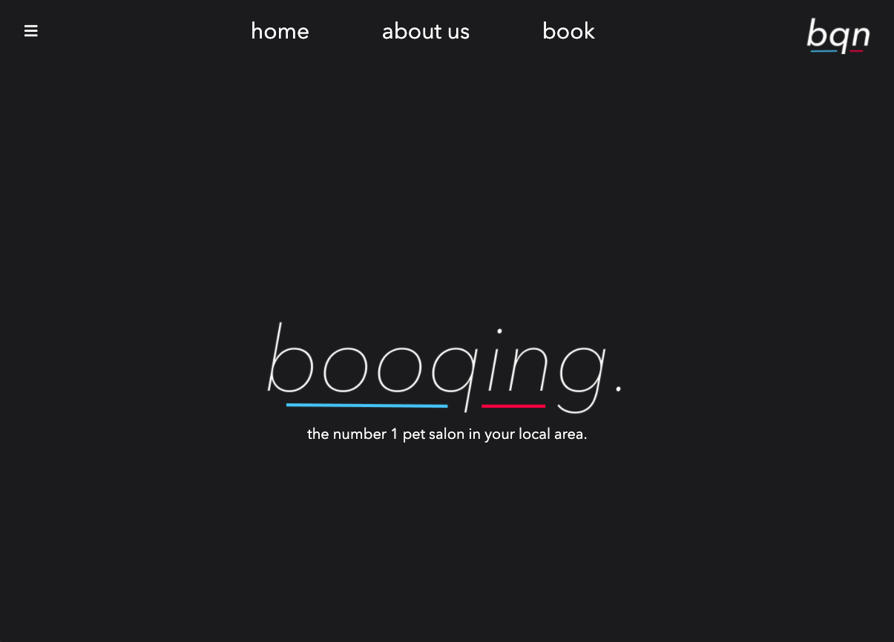
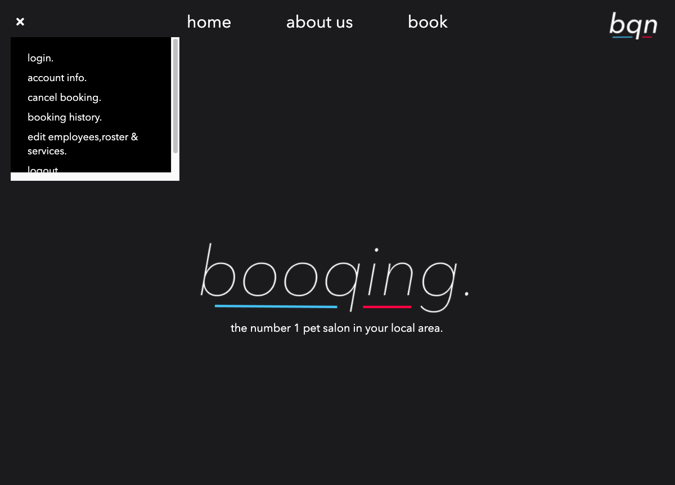
overview
Home link

Slide 3
Group Retrospective
By Yong xing Zhang
Effective communications
Sprints are delivered on time
Failed to follow tutor’s instruction has caused a delay in sprint 2
Industrial-like experience broadened up future career opportunities

Slide 4
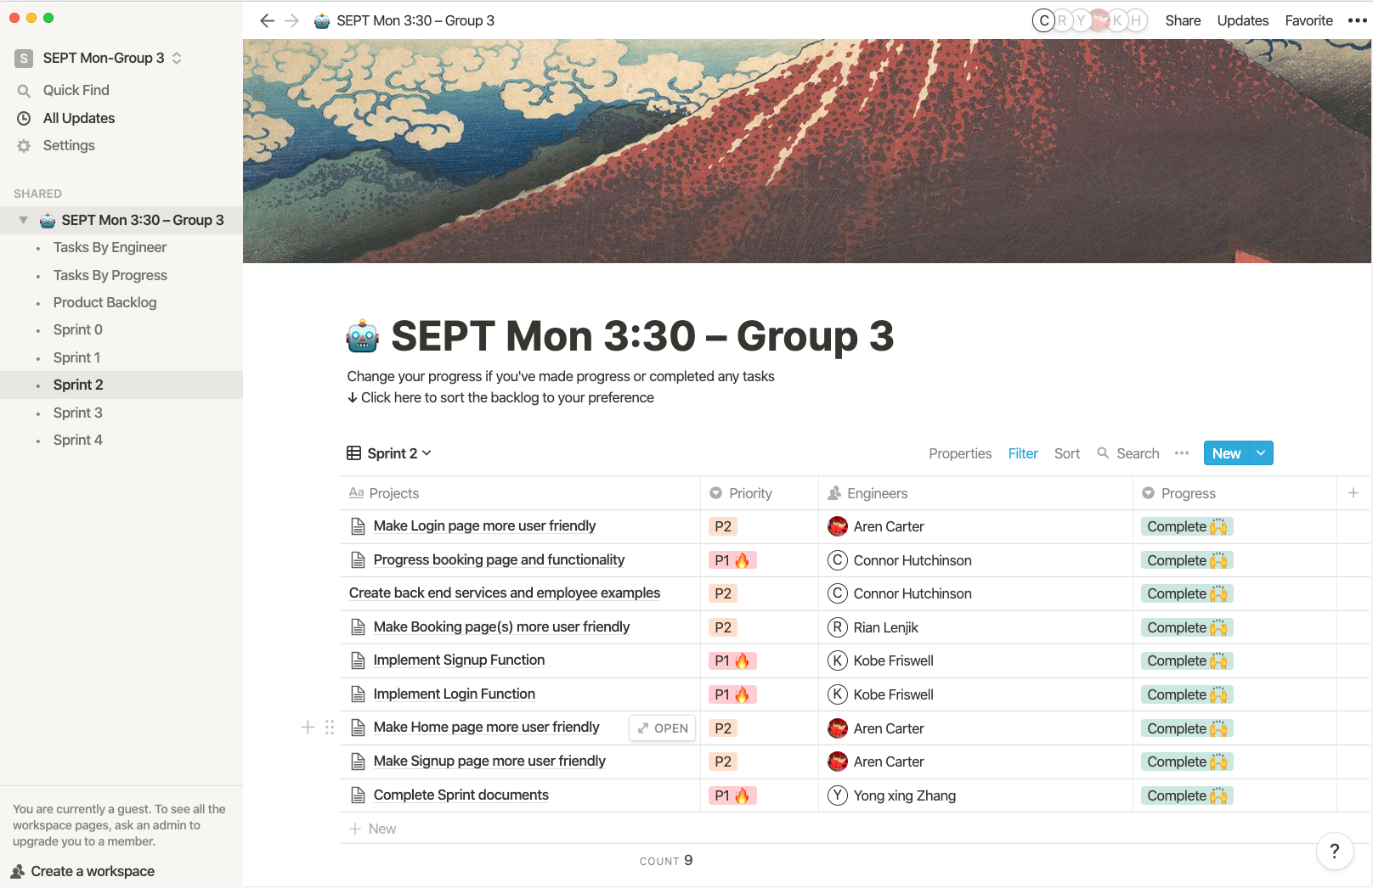
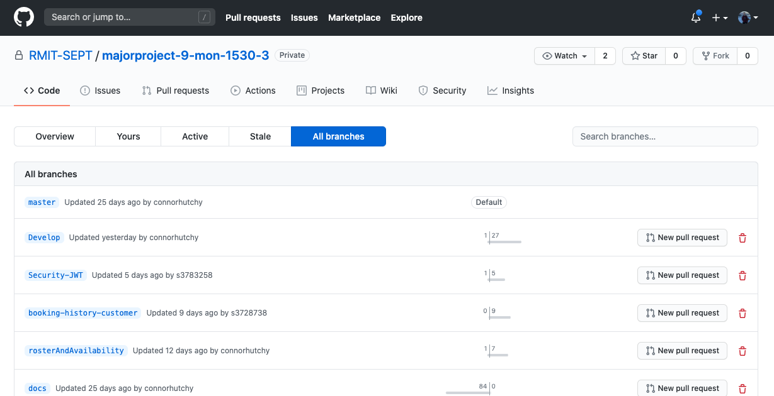
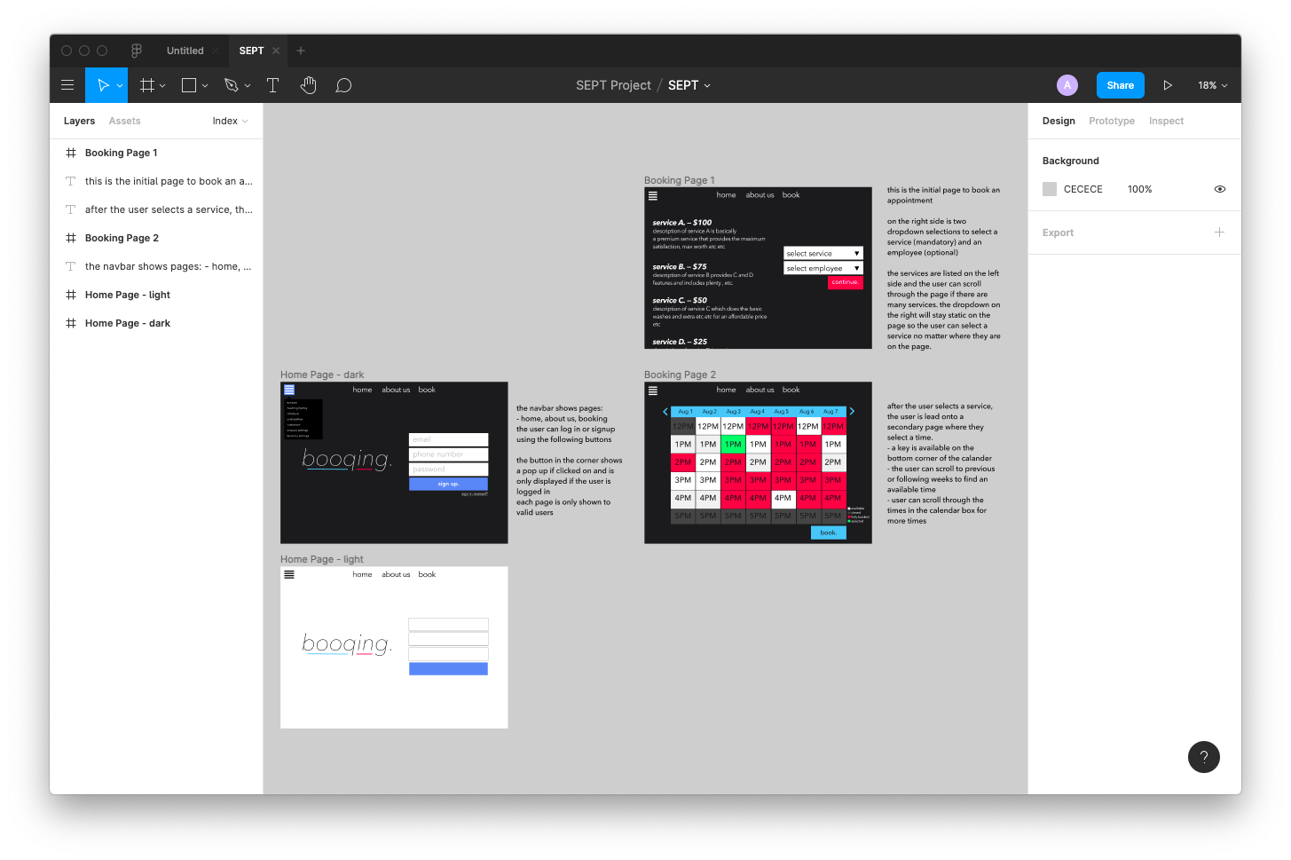
Tools Used
By Aren Carter
Product Backlog:
Notion
Communication:
Discord
MS Teams
Git:
GitHub
Design:
Figma

Slide 5
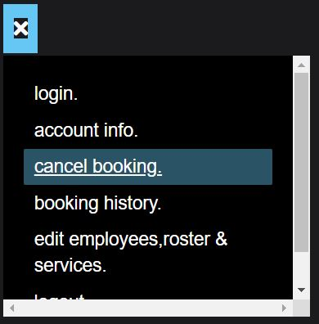
Design Choices
By Aren Carter
Simpler designs and aesthetic improvements
Home, About Us and Book pages listed at the top as it’s what regular users would want to click most often
Other links that users may want to find are listed in a nav menu icon that pops up after a user clicks on it

Slide 6
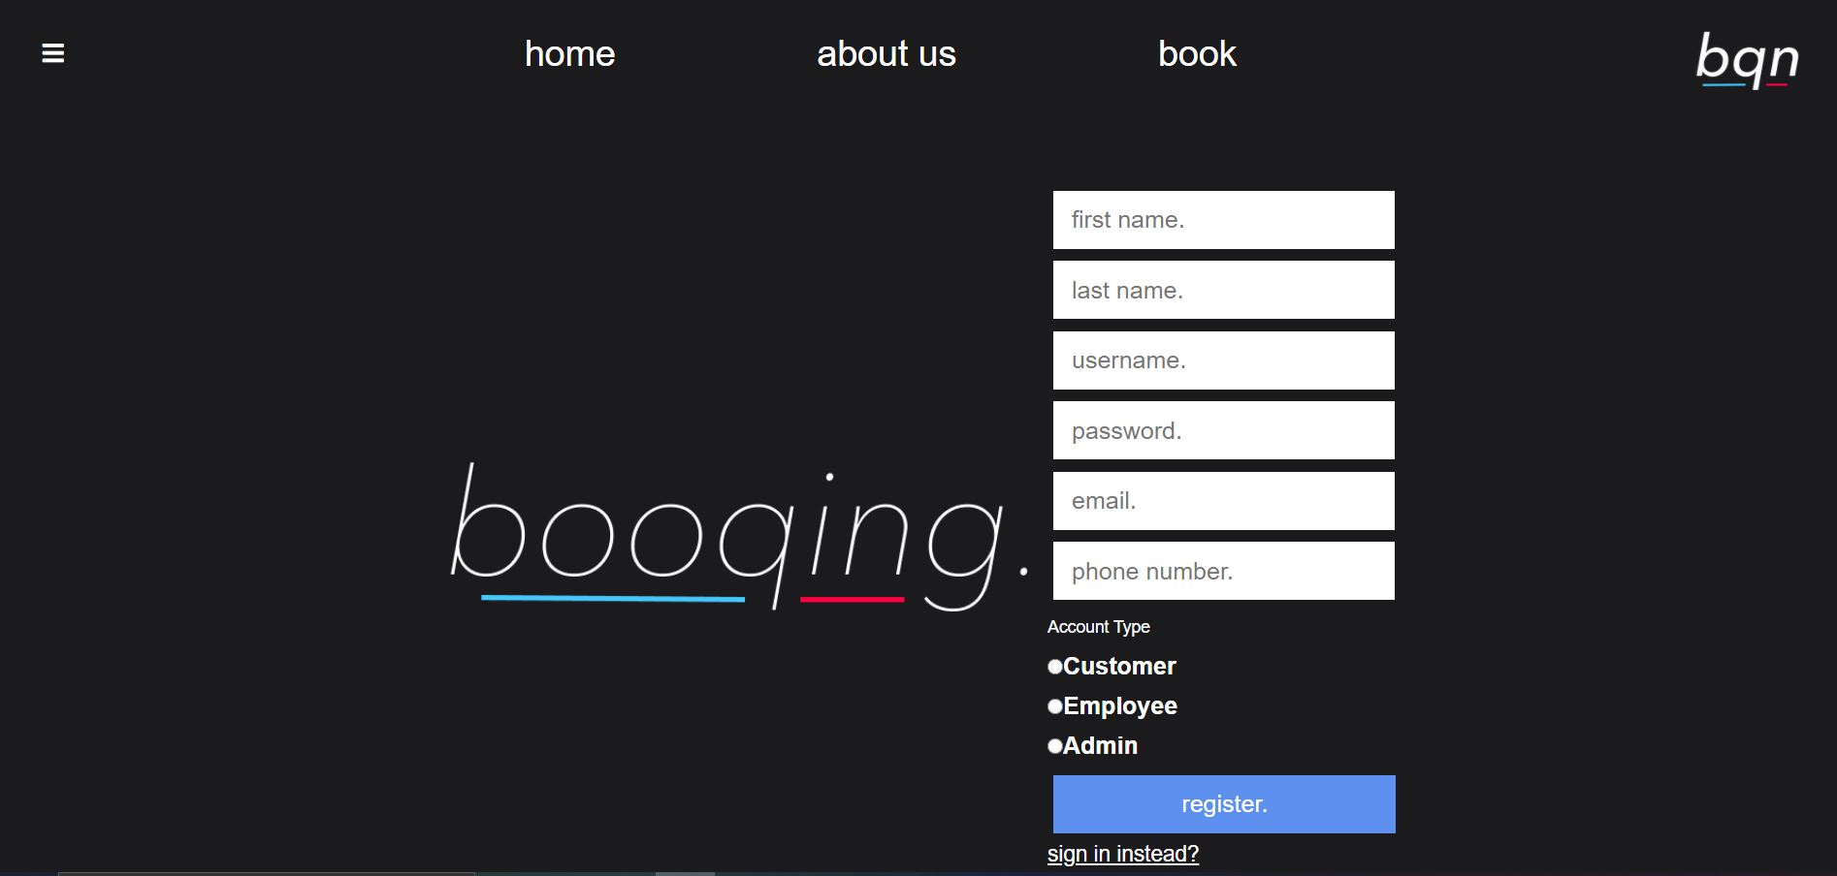
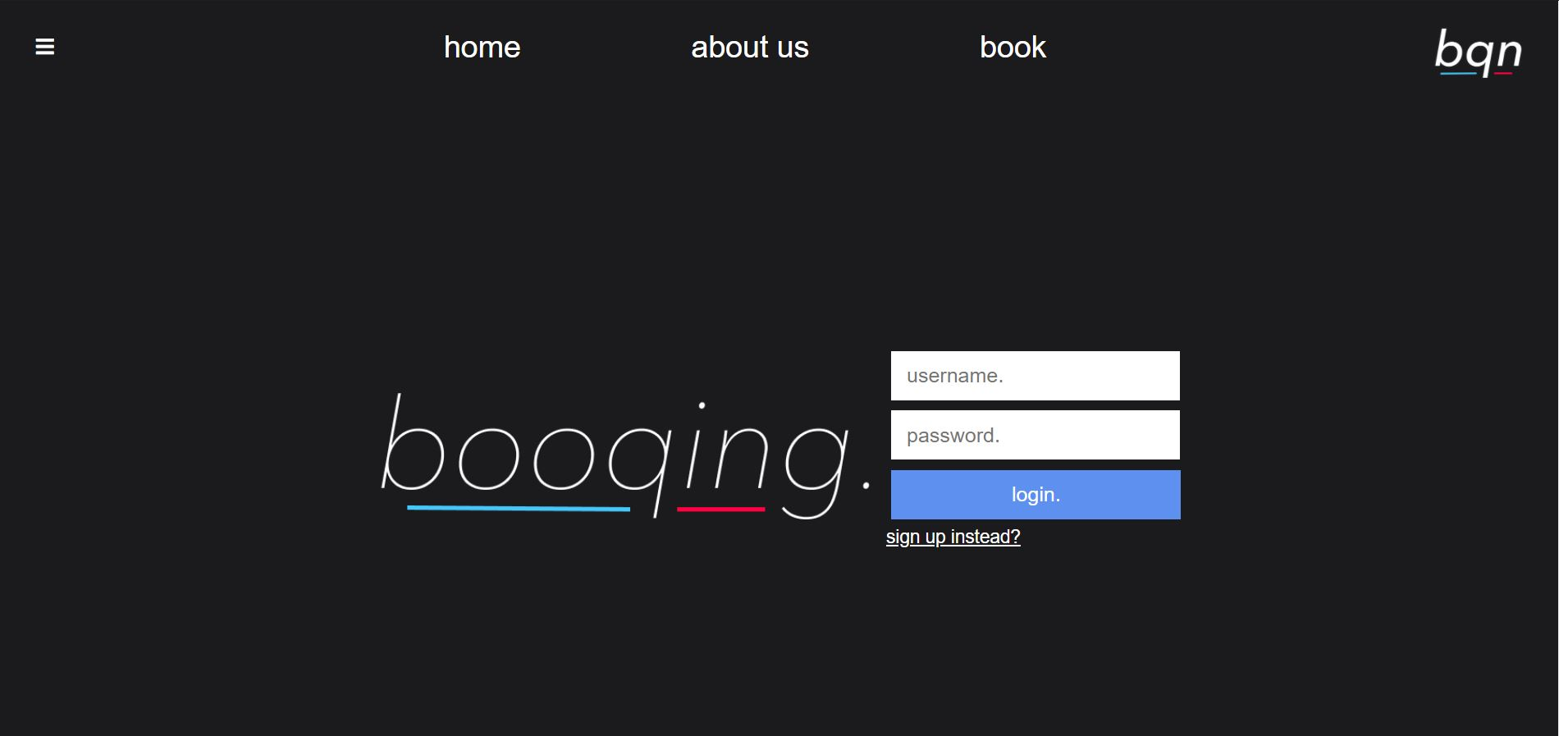
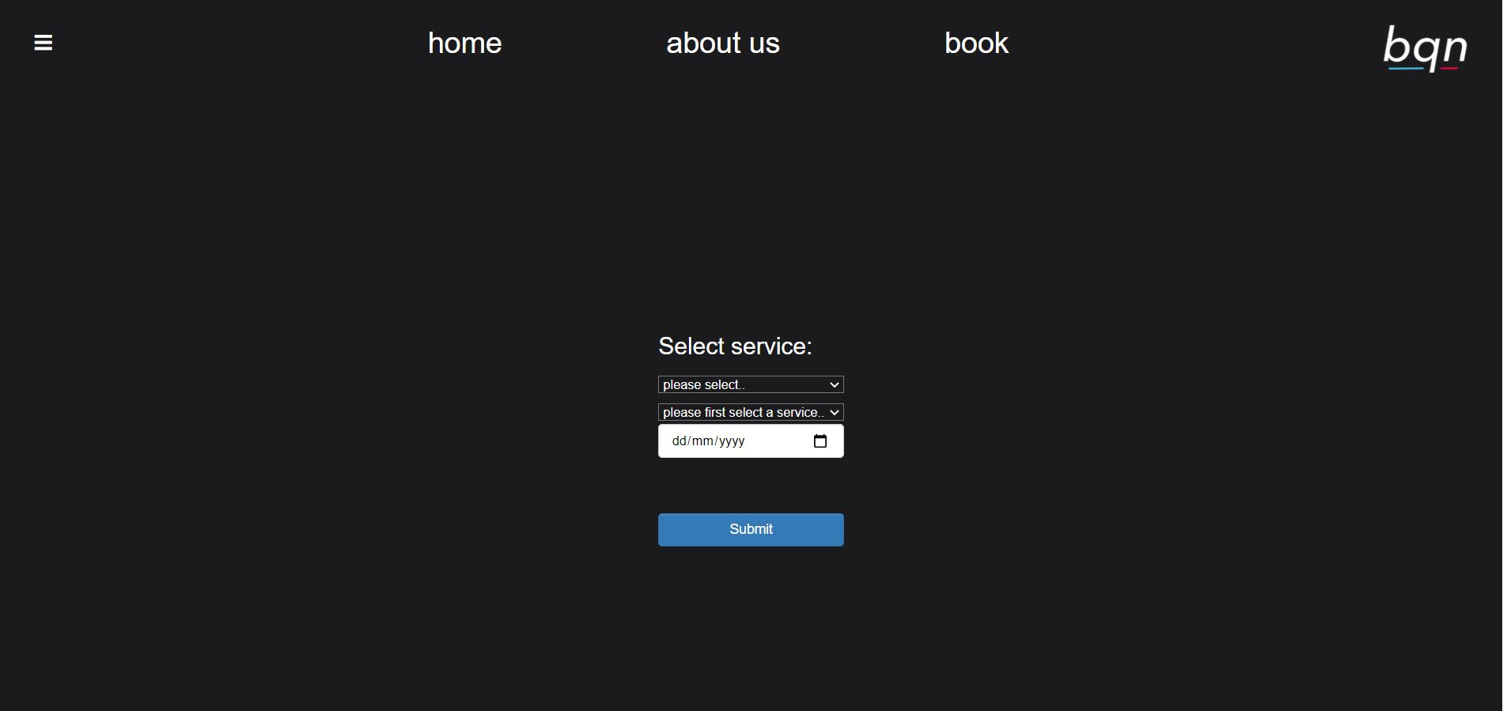
Created registration, login, and booking pages
By Rian Lenjik

Slide 7
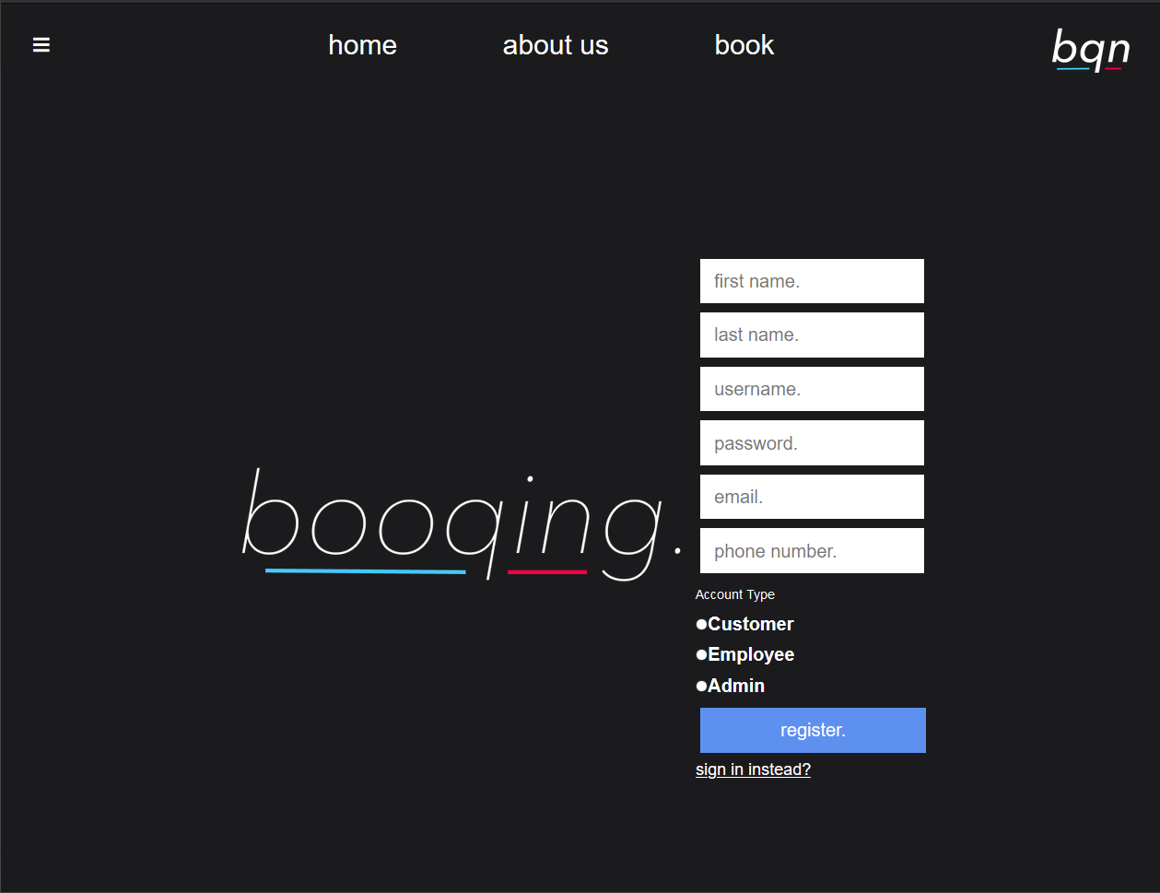
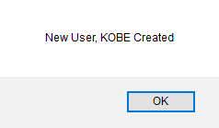
Registration
By Kobe Friswell
Creating a new account page
Allows for user creation with different contact details
Encrypted password saved to database
Confirmation of account creation
Different account types with different authorities

Slide 8
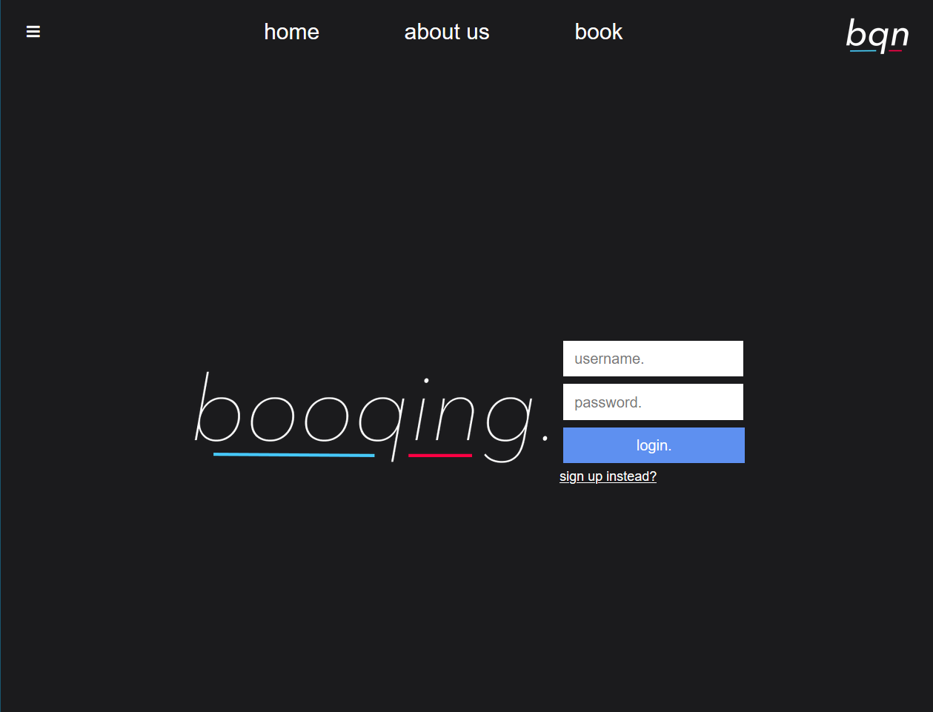
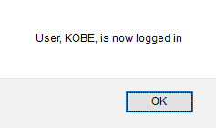
User Login
By Kobe Friswell
Homepage/User Login
Unique username
Encrypted password
Confirmation on login where jwt is used to access username and user type
After login jwt token is saved to session

Slide 9
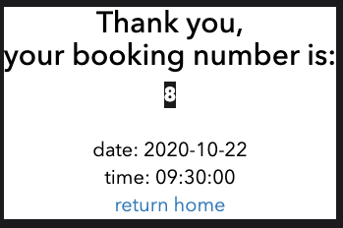
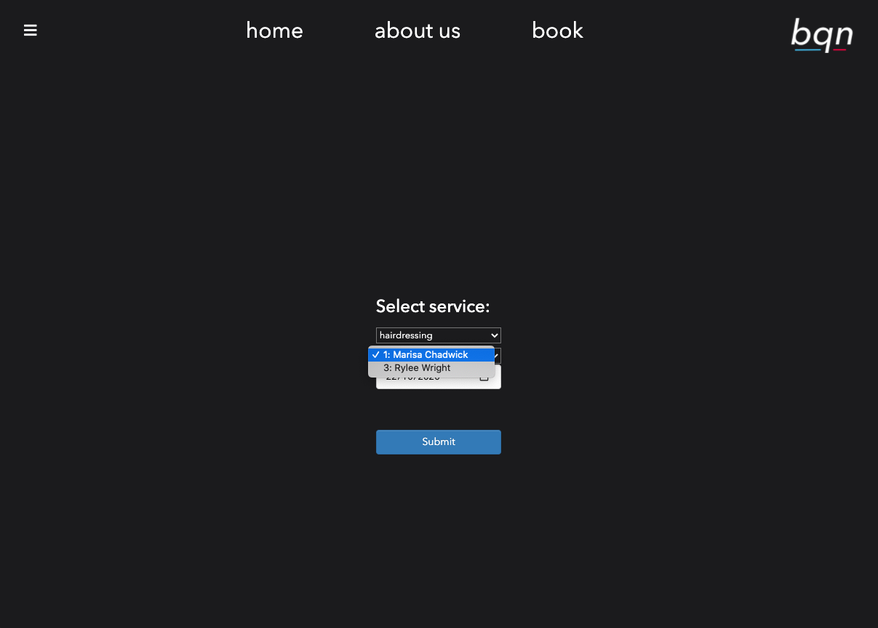
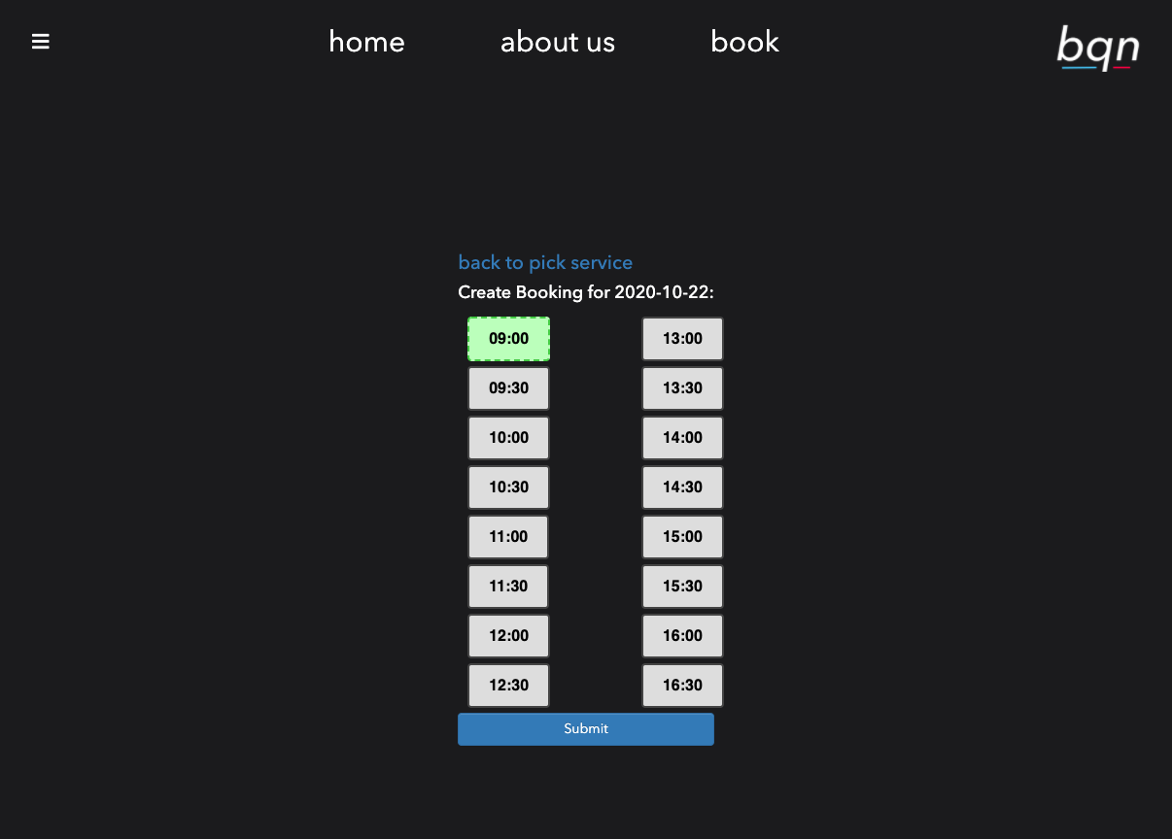
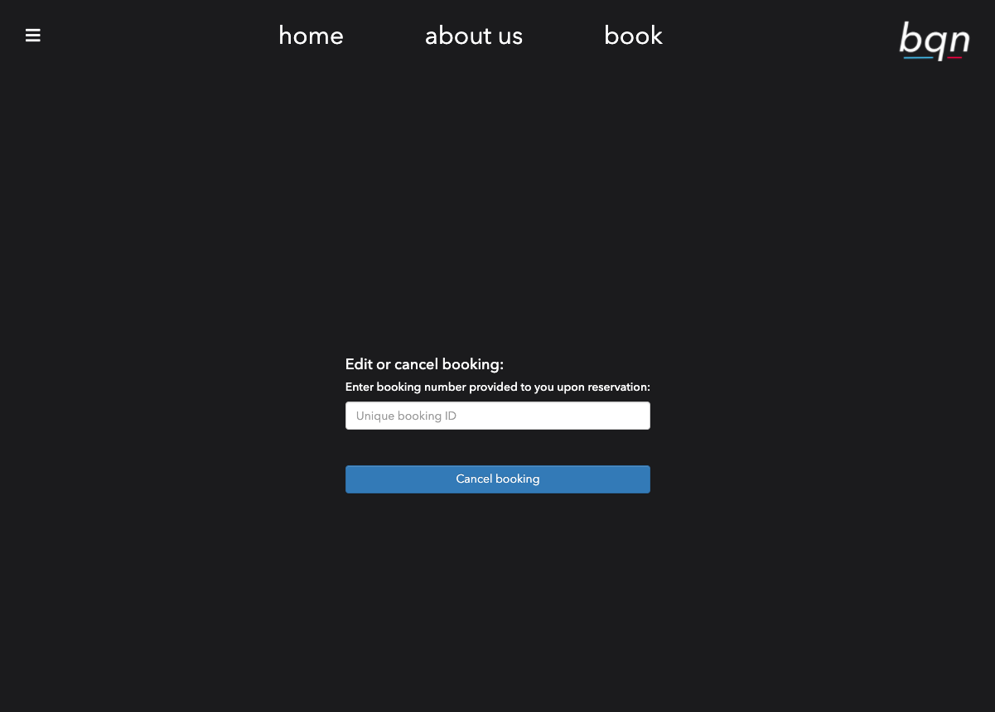
Booking creation
By Connor Hutchinson
Step by step booking
Ease of use -
Choose service
Choose prefered employee
Choose date
Choose time
Receive receipt
Safe booking deletion by requesting booking ID

Slide 10
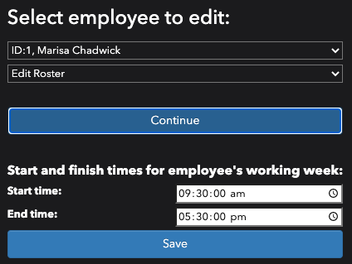
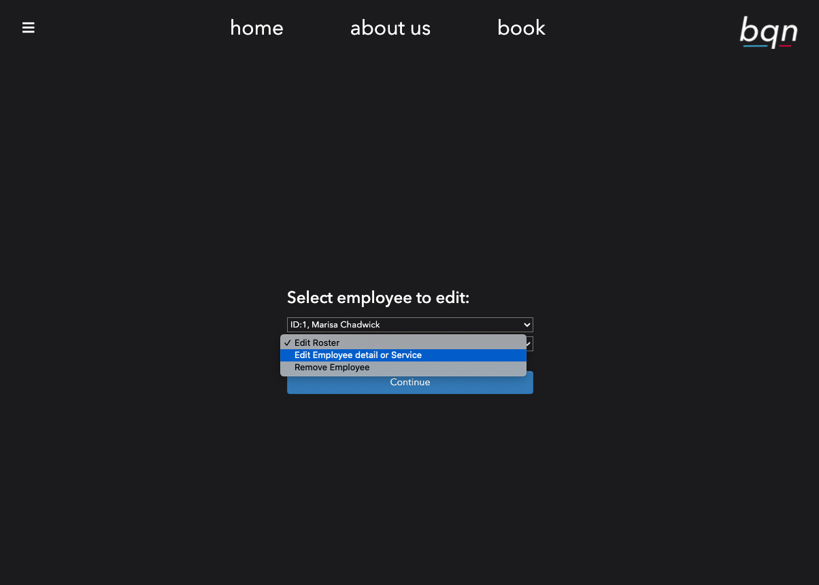
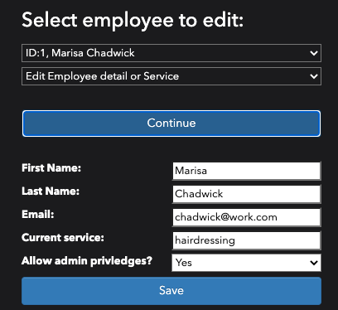
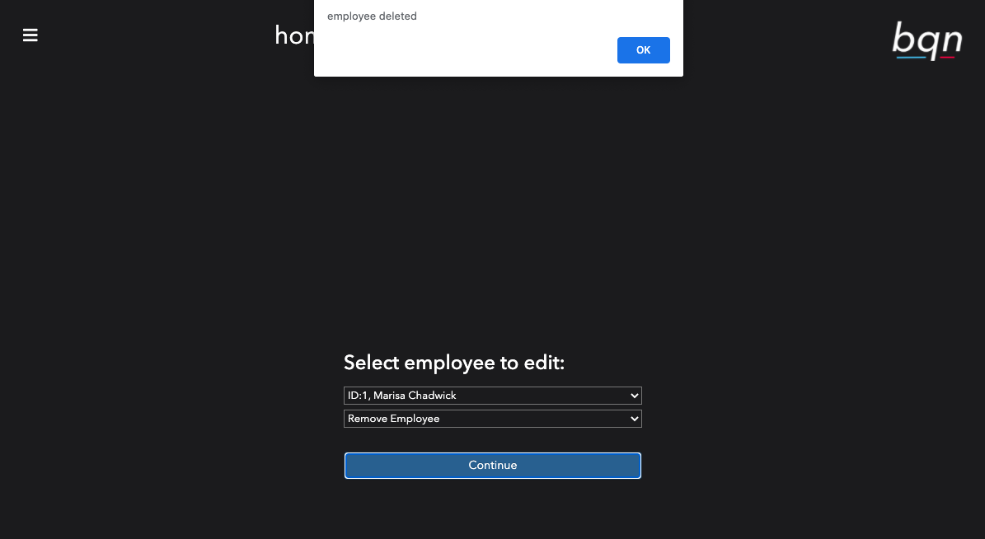
Employee and roster editing
By Connor Hutchinson
Simplified multiple choice
Edit each employee individually
Choice of editing:
Roster
Employee details
Employees service
Removing the employee

Slide 11
Thanks for listening!

